Slide 1




OO02: SQL Injection Attack Detection & Prevention
Progress Update – Second Meeting
GitLab Link: https://gitlab2.eeecs.qub.ac.uk/40228223/sql-injection-attack-detection-and-prevention

Slide 2
EPSS vs OWASP RRM
EPSS
OWASP Risk Rating Methodology
The research is based on data collected from specific data partners which might be lacking in coverage.
Since EPSS rely on signature-based methods – it might not be able to detect zero-day attacks
The prediction system is limited to a specific time window of vulnerabilities (30 days).
The system only considers vulnerabilities with CVE identifiers, leaving out other types of software flaws or misconfigurations that could be exploited.
Limited Context and Risk Assessment: The scoring system provided by EPSS offers estimates of threats but does not take into account factors such as a company's assets, operating environment, security controls, or potential loss resulting from exploitation.
Bias: Different individuals may have varying opinions on the severity and impact of a particular vulnerability, leading to inconsistent risk ratings.
The methodology lacks specific recommendations or best practices for remediation strategies.
The OWASP Risk Rating Methodology, on the other hand, is primarily focused on assessing risks associated with web applications..

Slide 3
EPSS and ORRM
Use the likelihood of exploitation for each vulnerability.
Since EPSS only works on assigned CVEs, map the various SQLi classifications to relevant CVEs.
Implement factors such as technical impact, business impact, exploitability from ORRM.
Planning to combine the predictive capabilities of EPSS in terms of exploit likelihood while incorporating the comprehensive risk evaluation provided by ORMM. This integration allows you to consider both the probability of exploitation and the broader impact of vulnerabilities.
“(EPSS) lacks the ability to account for an individual vulnerability’s context in its calculation, and thus is currently unsuitable as a primary risk score. Perhaps information such as vulnerability exposure and device business value could be combined with the threat score of EPSS to create a more comprehensive risk scoring system.”

Slide 4
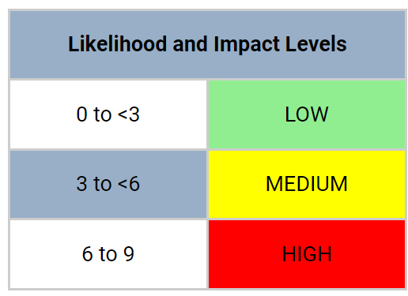
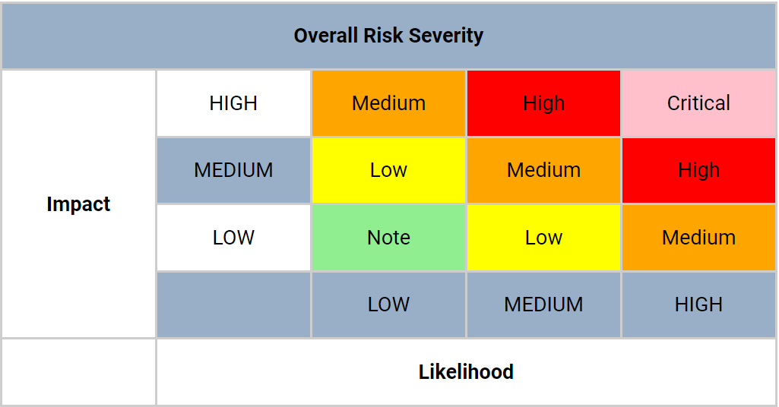
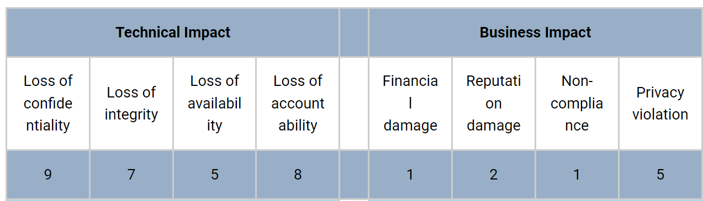
OWASP RRM & EPSS: Risk Modelling
Risk = Likelihood * Impact
Likelihood = AVG(Threat Agent Factors + Vulnerability Factors + Exploitation Activity Probability)
Impact = AVG(Technical Impact + Business Impact)
Threat agent Factors:
Skill level, Motive, Opportunity and Size
Vulnerability Factors:
Ease of Discovery, Ease of Exploit, Awareness, Intrusion Detection
Impact Factors:

Slide 5
Research Questions
RQ1. What are the current state-of-the-art SQL injection attack detection and prevention approaches?
The state-of-the-art approaches will be examined to evaluate the effectiveness and completeness of modern solutions to detect and categorize SQL injection attacks.
RQ2. What are the limitations in current SQL Injection Attack Detection and Prevention solutions?
The aim of this project will be to perform gap analysis on the identified state-of-the-art SQL injection attack detection and prevention approaches. This research will use the consequent results to develop a new solution that will address the limitations in current state-of-the-art solutions
RQ3. What are the different classifications of SQL Injection attacks and the associated risk factor?
The research will aim to perform risk modelling on the identified SQL Injection classifications to accurately identify the severity of each attack type. This allows organizations to quantify the potential impact of SQL injection attacks

Slide 6
Contributions
The project will compile and classify different types of SQL injection types and perform risk modelling to determine the exploitability factor and the specific impacts of each SQL injection attack type thereby facilitating attack prioritization.
It will identify additional improvements that can be made to the detection and prevention mechanics of current solutions.
The project aims to propose an active SQL injection (SQLi) detection and prevention solution that addresses the limitations of current approaches. This solution will actively detect, alert, prioritize and prevent SQL injection attacks from reaching the backend database.

Slide 7
Next Steps
Implement Multiclassifier
Test and Evaluate Other Classifiers (Random Forests, Naive Bayes classifier)
Implement Continuous Testing through Gitlab CI/CD Pipelines
Continue Literature Review on Risk Modelling

